Slide 1
Progress report REVION 2.0
VU MANH QUAN
NGUYEN TRUC NGUYEN
LAM QUOC BAO

Slide 2
ABOUT our web
It’s just a basic website for shopping and viewing computer’s hardware like
Motherboard, CPU, RAM, GPU, Storage, ….
But the main part is implemented a login system using face.

Slide 3
Overview
I
II
III
Build tools
Back-end
Front-end
VSCode based on Linux (WSL2)
Django project frame-work
SQLite
Django database admin
Bootstrap4

Slide 4
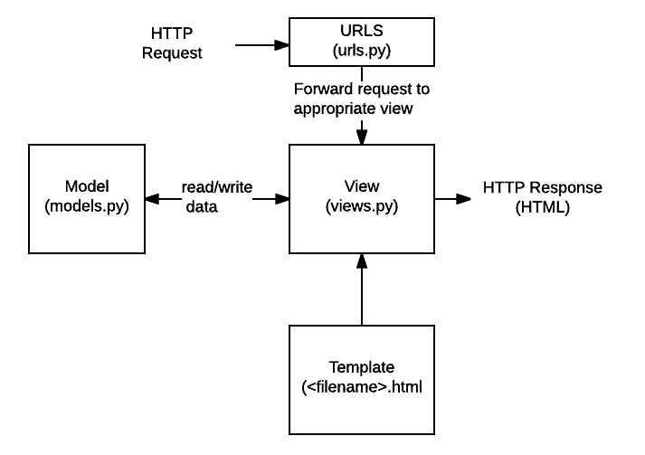
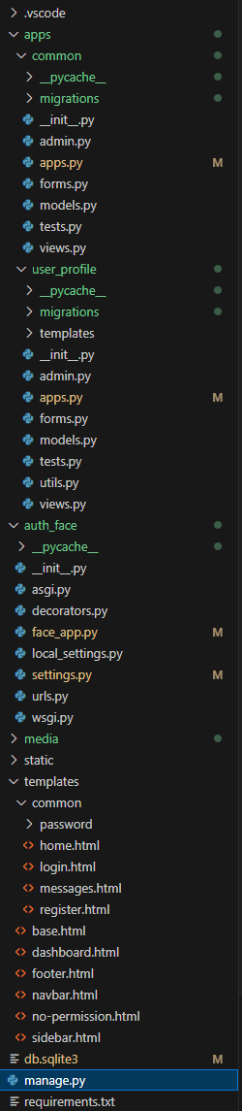
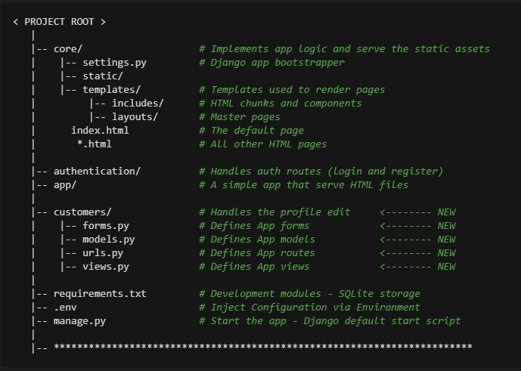

Basic config of the project

Slide 5
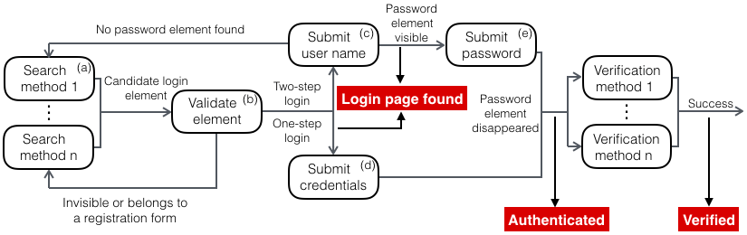
Overview of the login process

Slide 6
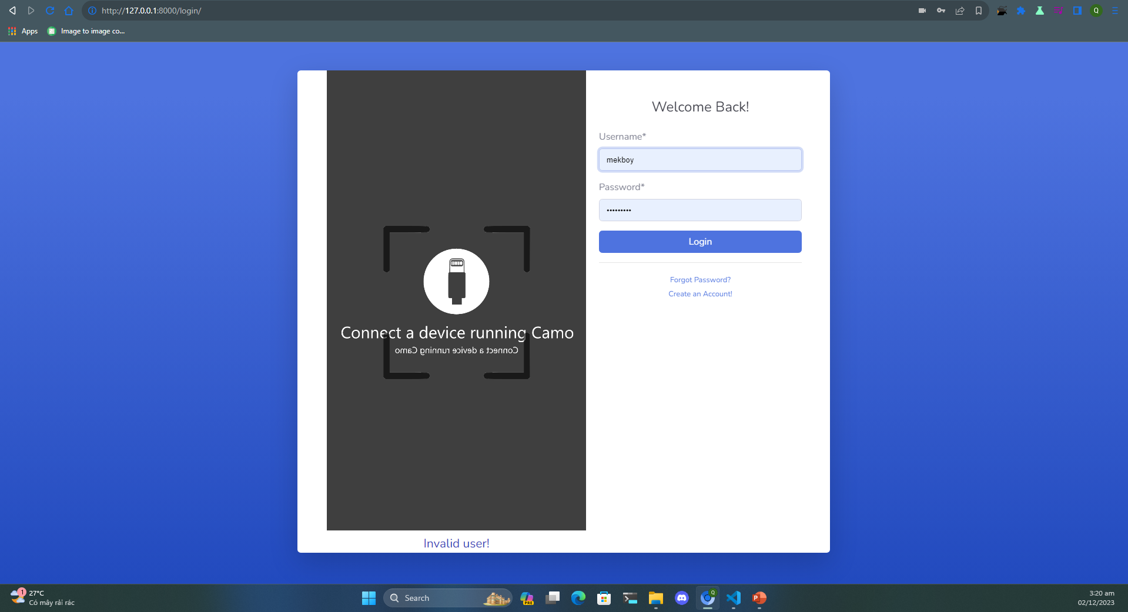

Slide 7
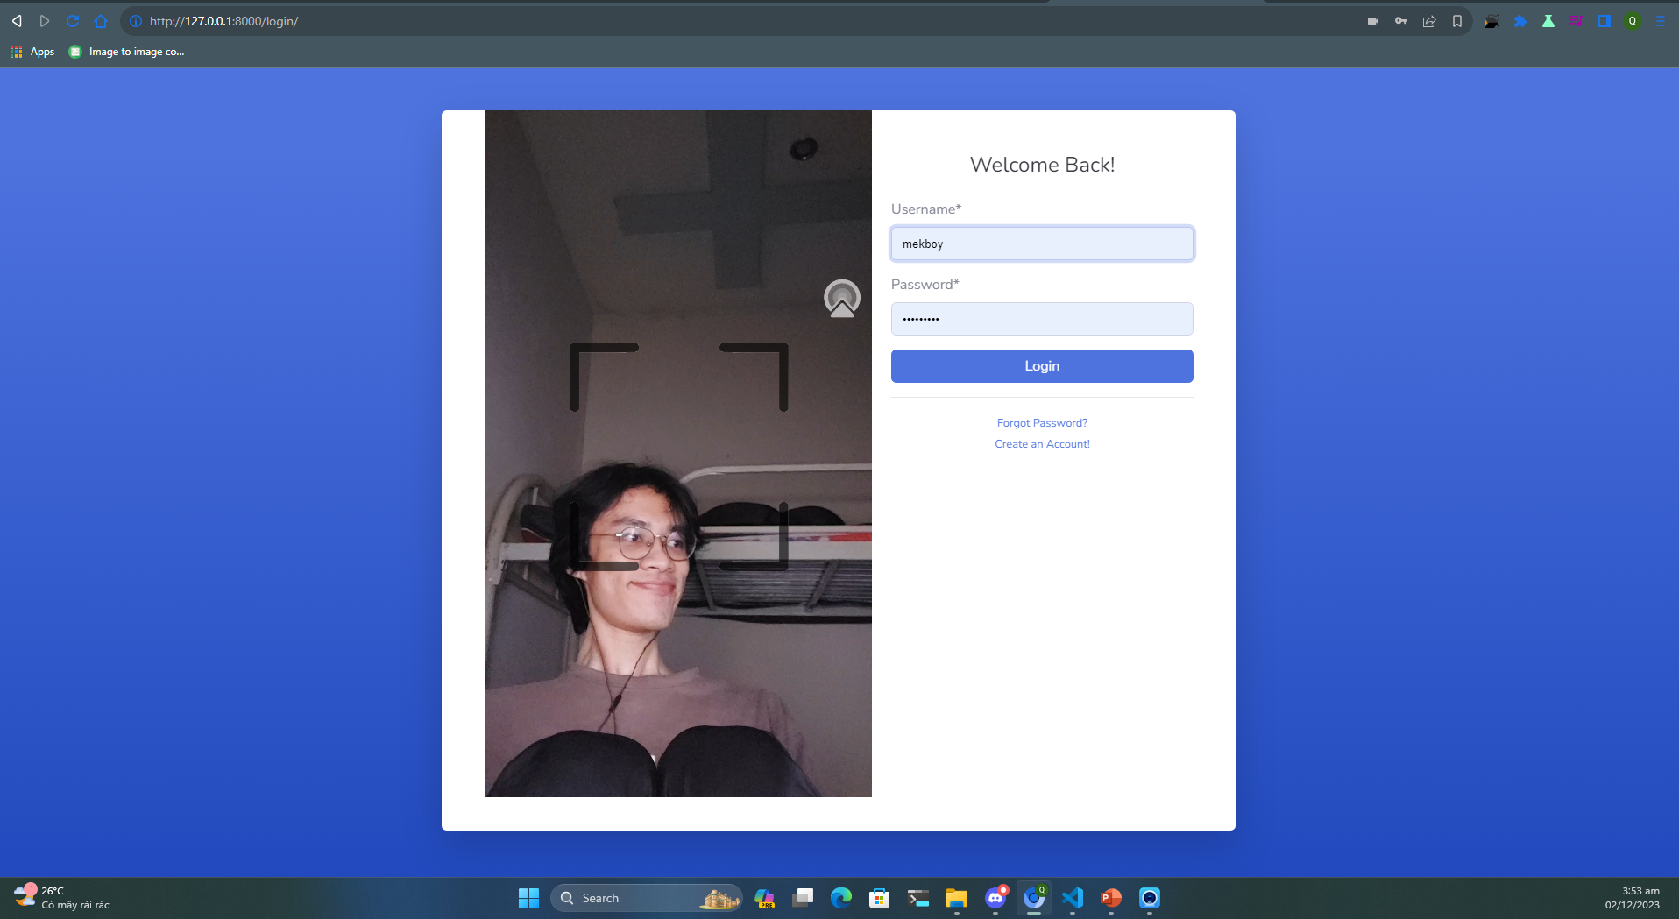




Slide 8
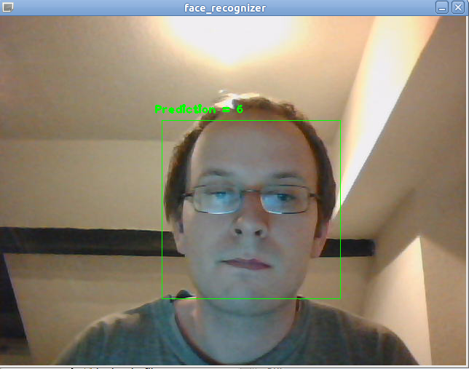
FACE-REC
- Based on project request, it need to fast, reliable
- Easy to implement
- So, we using InceptionResnetV1 and MTCNN

Slide 9
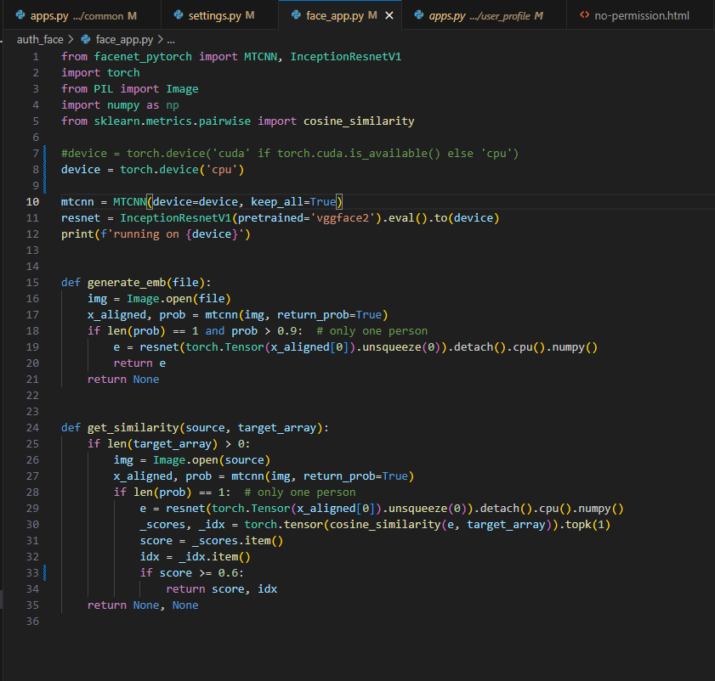

Slide 10
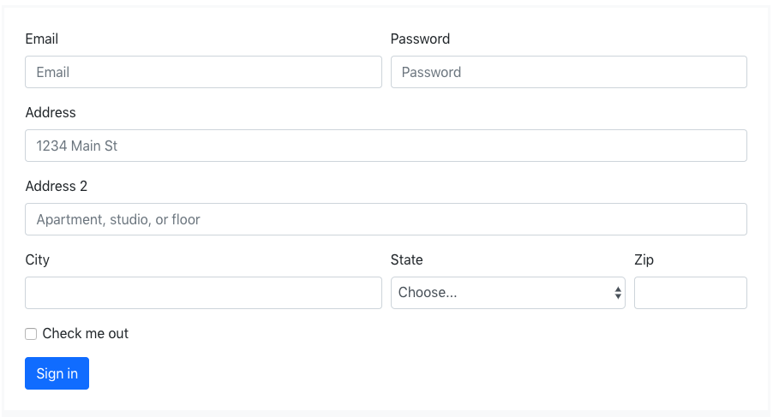
User interface
- Since Django doc recommend using their add-in framework called crispy-form, we decided to used it.

Slide 11
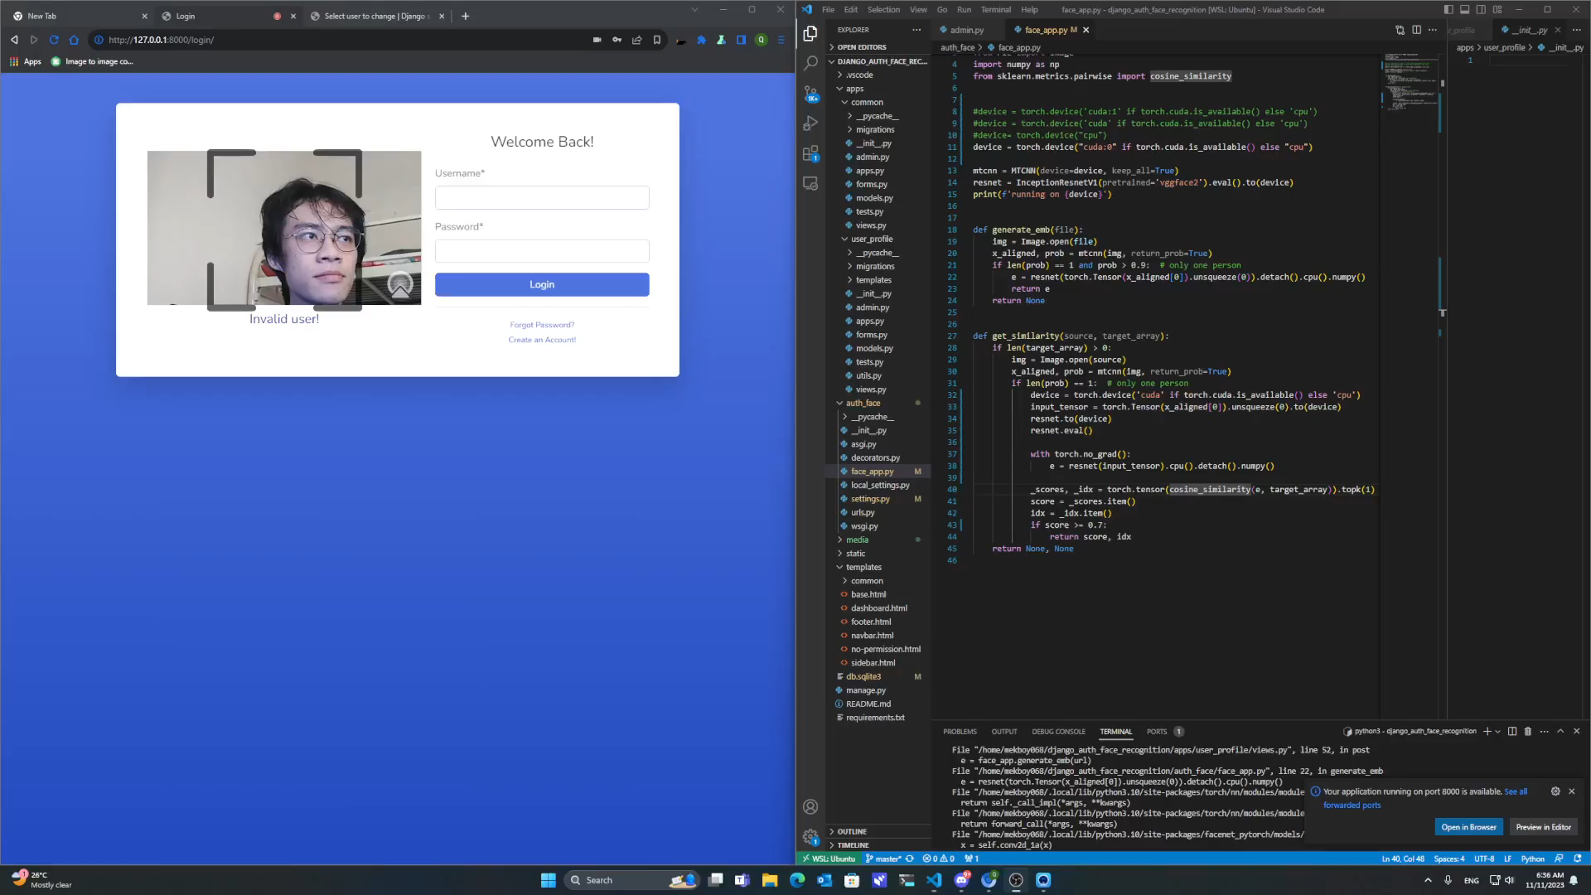

Slide 12
PRODUCT UI
OUR NEXT GOALS:
- VIEWING PRODUCTS
- BASIC SHOPPING CART
- MANAGE DATABASE

Slide 13
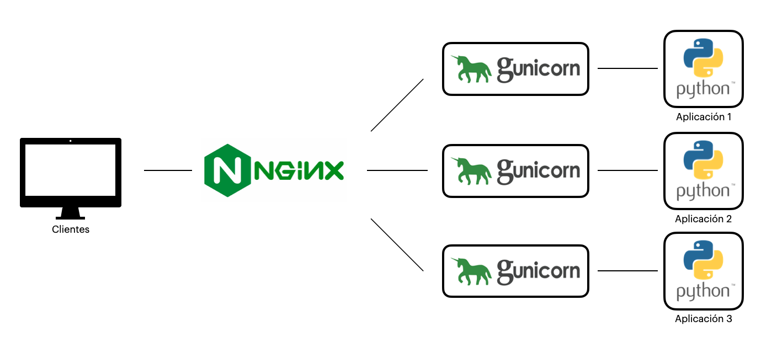

Slide 14
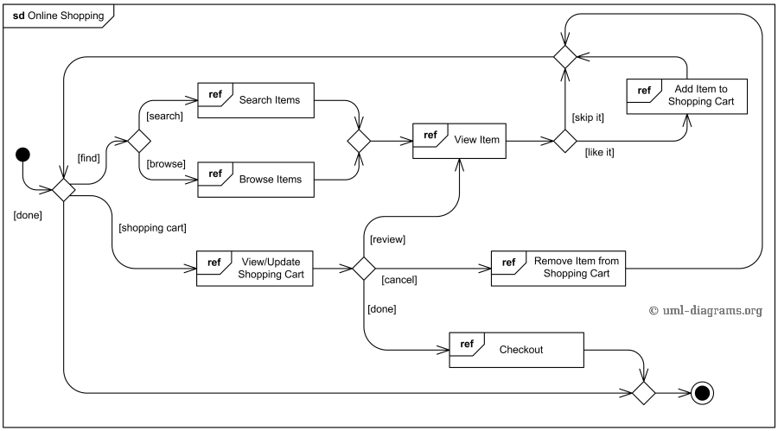

Slide 15
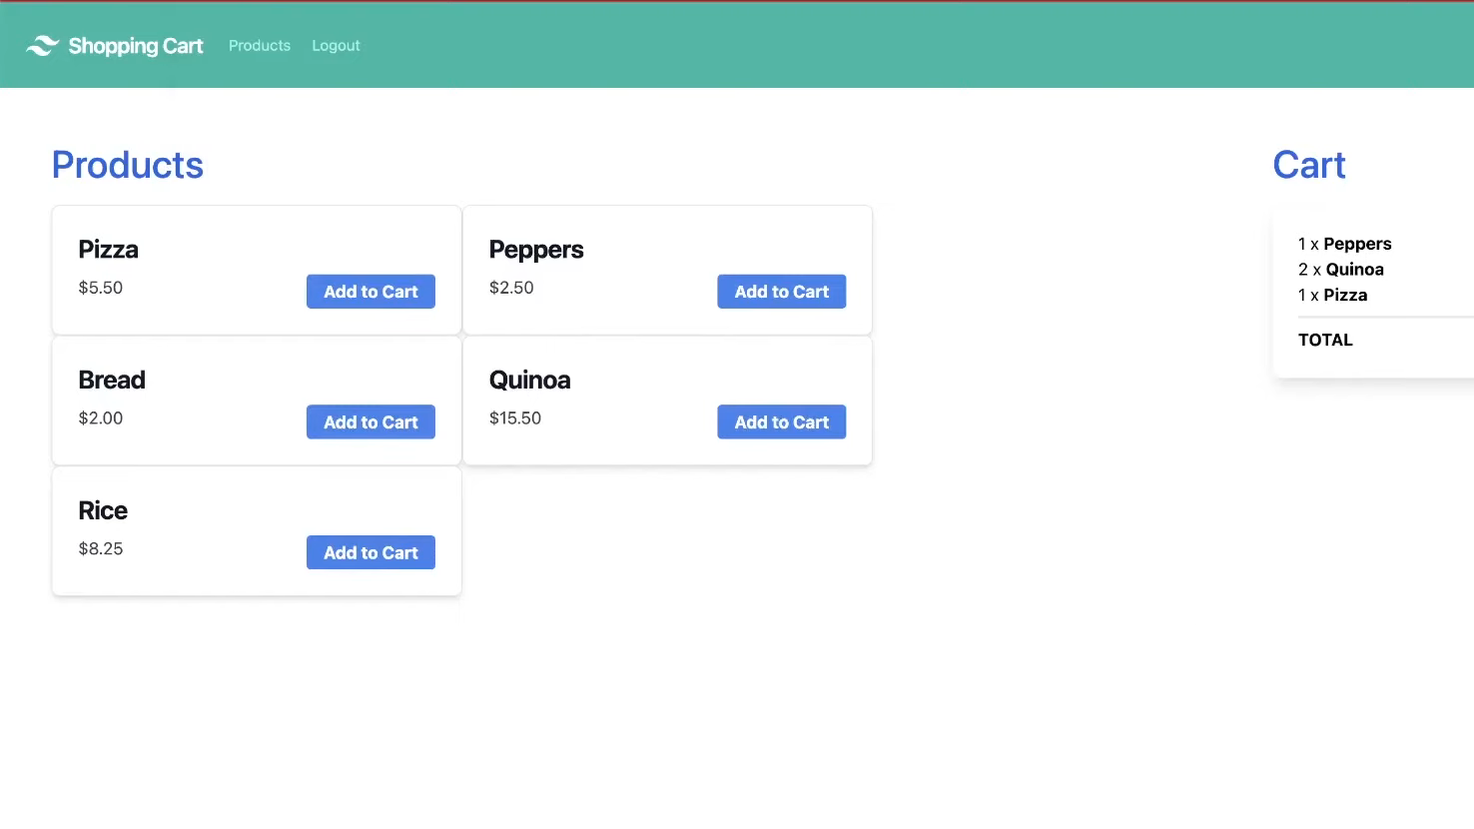

Slide 16
NEXT REQUIREMENTS
1
2
3
COMPLETE THE UI
Join the shopping cart and the login ui
Prepare for the next demonstration

Slide 17
THANK YOU

